Slide 1
Appendix 4: Mapping snapshots of change for (up to) three periods for all variables: 2002-2012, 1992-2012, and period-of-record beginning to 2012.
The variable short name is given in quotes in figure title.
Ha = hectares. HUC = Hydrologic Unit Code. Kg = kilograms. Lbs = pounds. Mgd = millions of gallons per day. Sq km = square kilometer. VPU = Vector Processing Unit (NHDPlus HUC-02 regions).
HUC-10 boundaries from National Resources Conservation Service, (https://nrcs.app.box.com/v/huc/folder/39640323180) (NRCS, 2018).
VPU boundaries from NHDPlus ,(http://www.horizon-systems.com/nhdplus/) (McKay et al., 2012).
State boundaries from 2010 U.S. Census cartographic boundaries (https://www.census.gov/geo/maps-data/data/cbf/cbf_state.html).
Coordinate system: Albers Equal-Area Conic Projection NAD83
Projection: Albers
Datum: North American 1983
False Easting: 0
False Northing: 0
Central Meridian: -96.0000
Standard Parallel 1: 29.5000
Standard Parallel 2: 45.5000
Latitude of Origin: 23.0000
Units: Meter

Slide 2
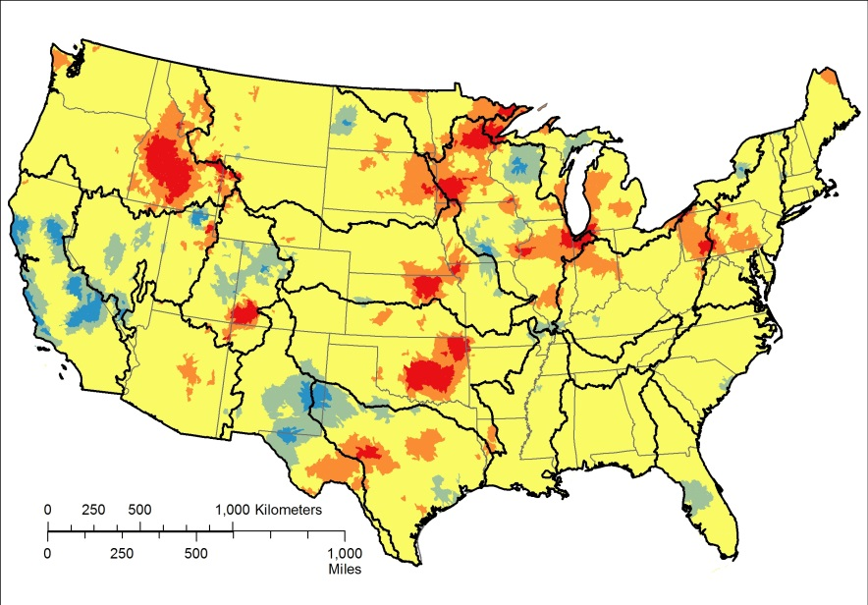
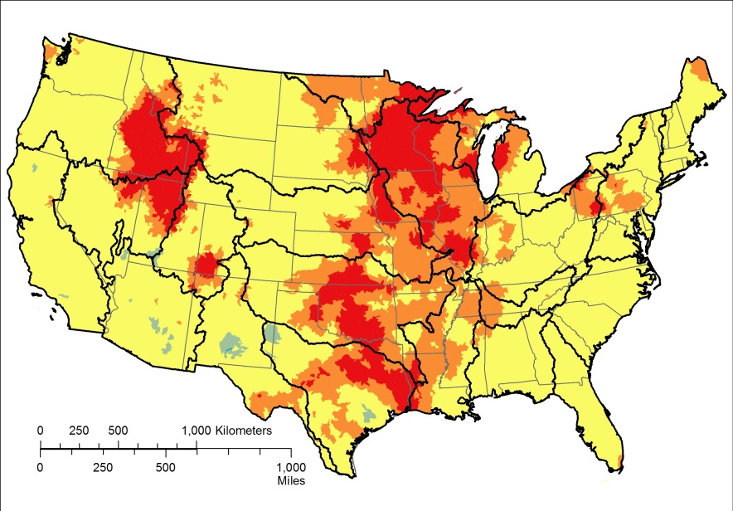
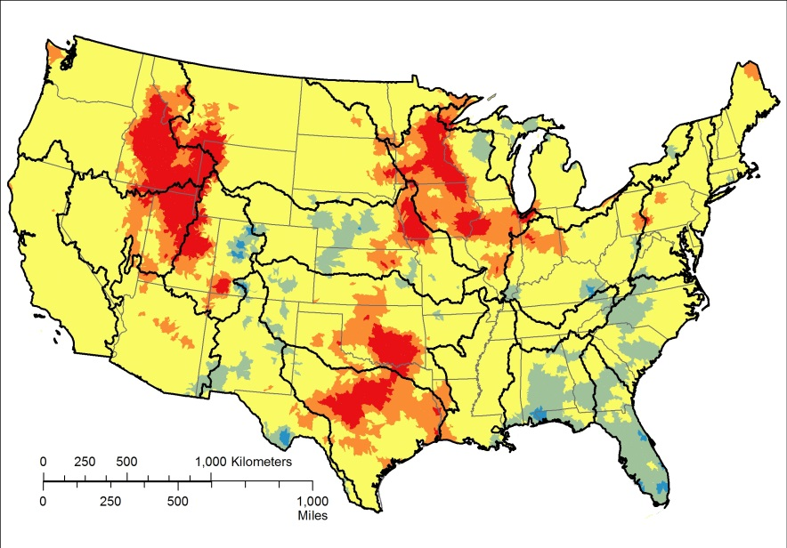
Atmospheric deposition of calcium, kg/ha, 1985-2012, “atmdep_ca”
10 year change
(2002-2012)
20 year change
(1992-2012)
Period of record change (1985-2012)

Slide 3
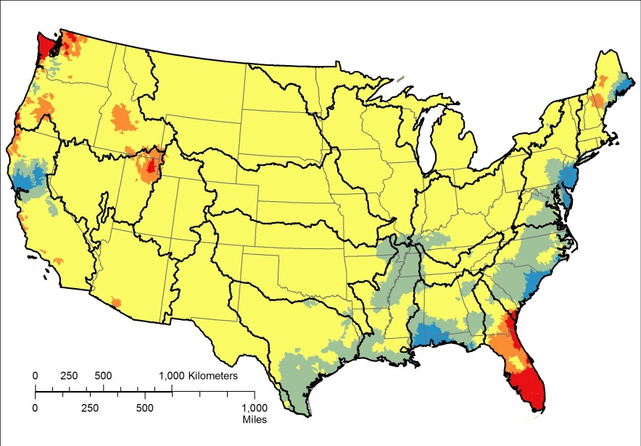
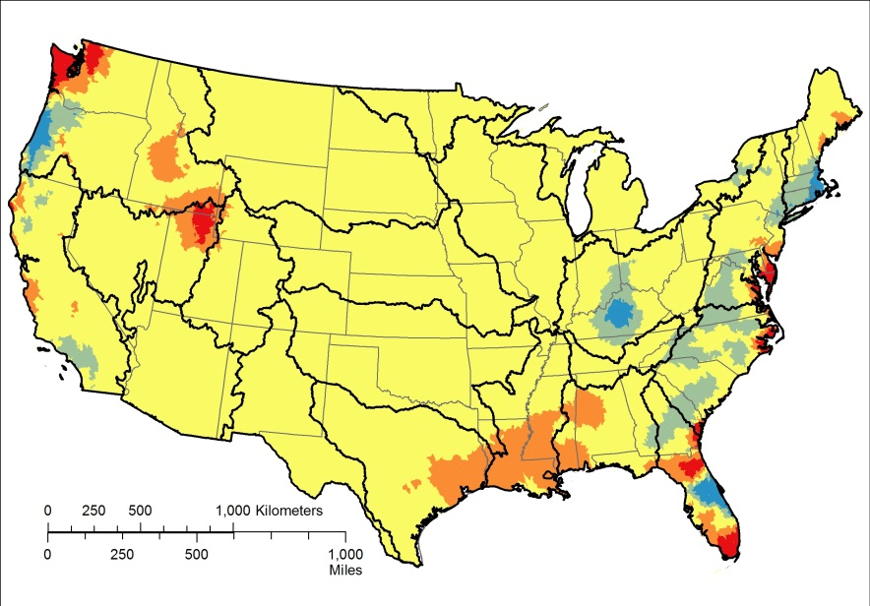
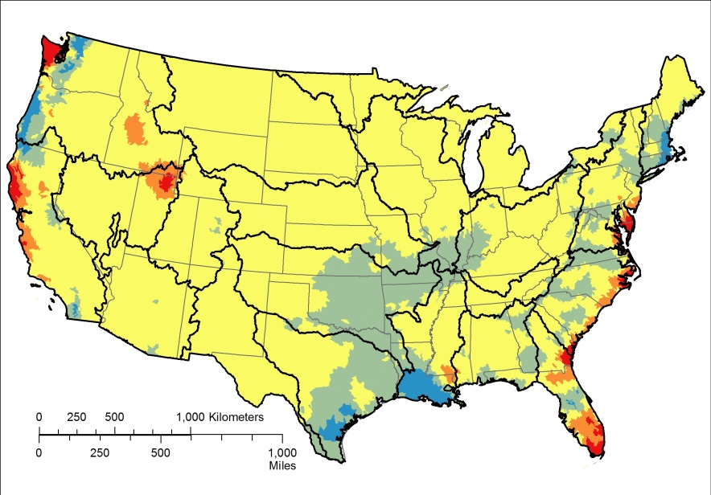
Atmospheric deposition of chloride, kg/ha, 1985-2012, “atmdep_cl”
10 year change
(2002-2012)
20 year change
(1992-2012)
Period of record change (1985-2012)

Slide 4
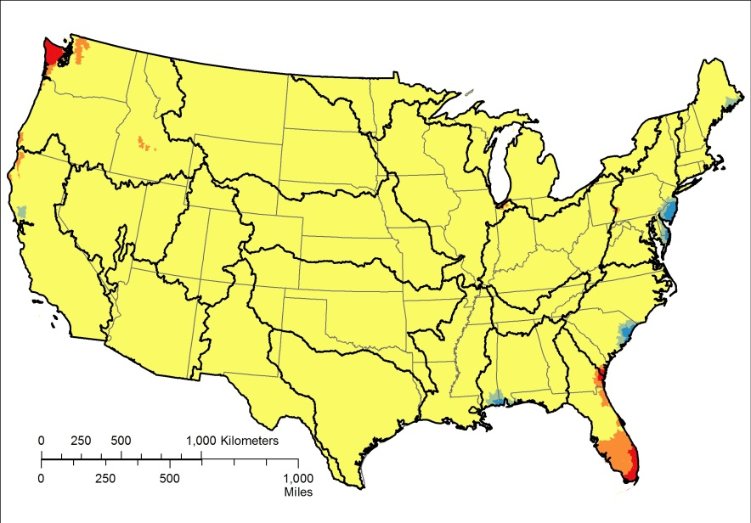
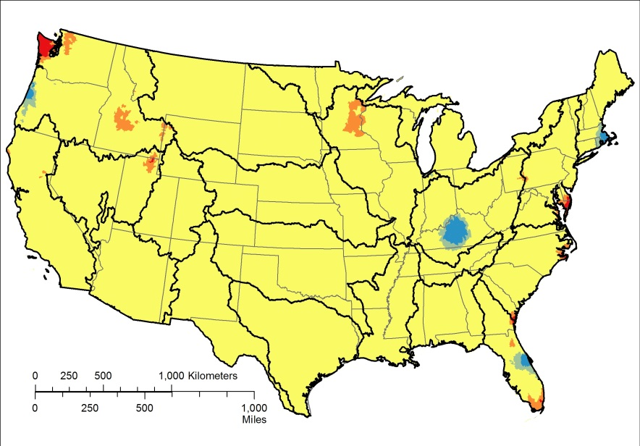
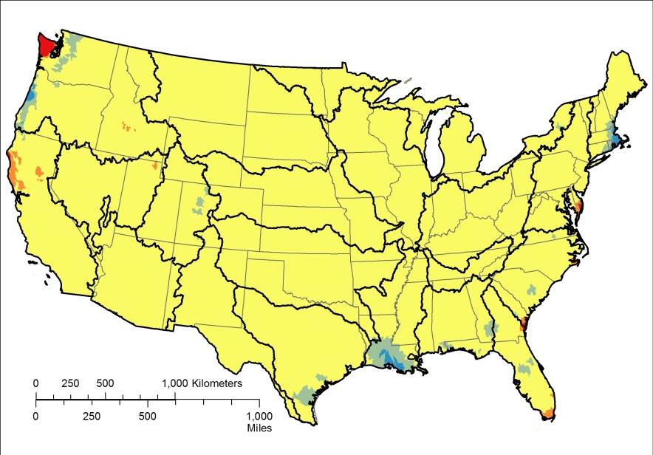
Atmospheric deposition of magnesium, kg/ha, 1985-2012, “atmdep_mg”
10 year change
(2002-2012)
20 year change
(1992-2012)
Period of record change (1985-2012)

Slide 5
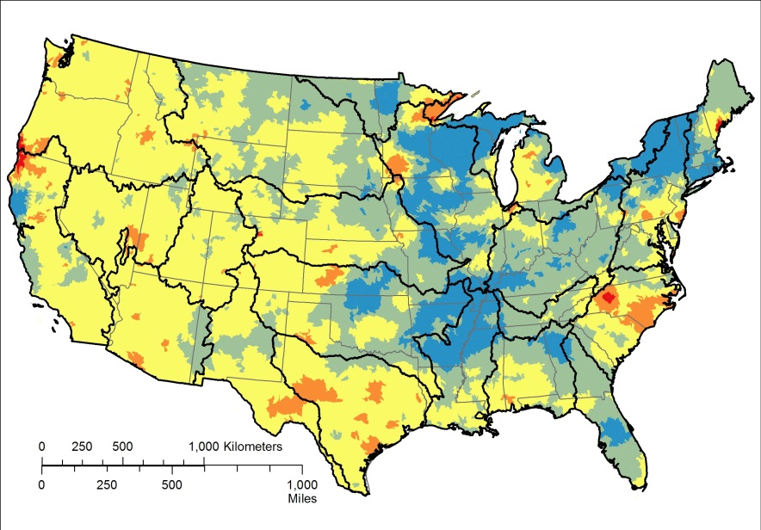
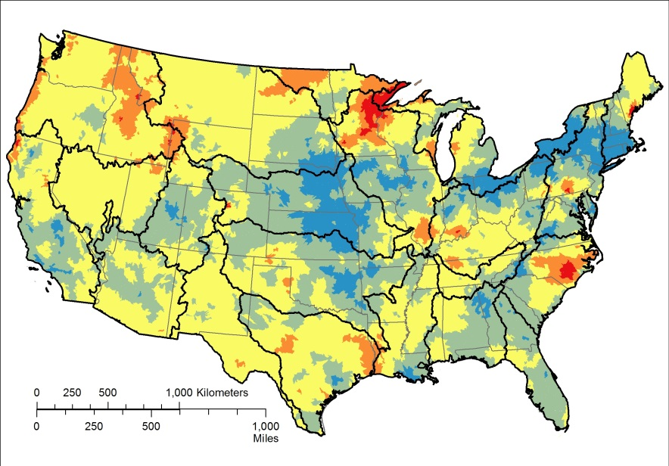
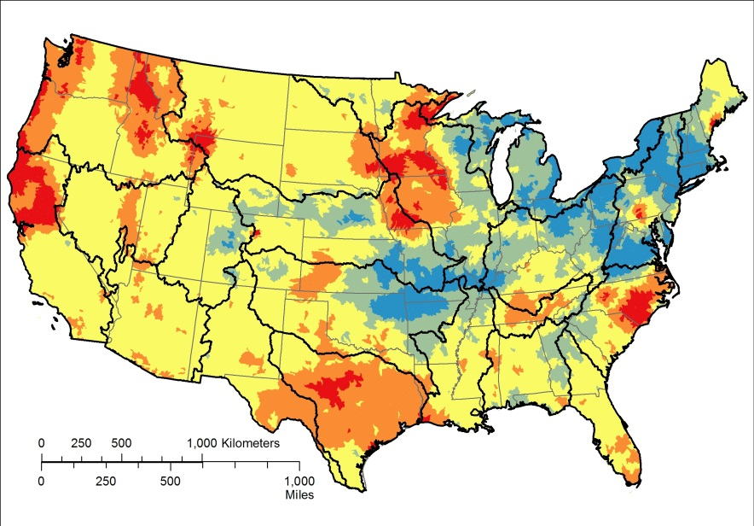
Atmospheric deposition of nitrogen, kg/ha, 1985-2012, “atmdep_n”
10 year change
(2002-2012)
20 year change
(1992-2012)
Period of record change (1985-2012)

Slide 6
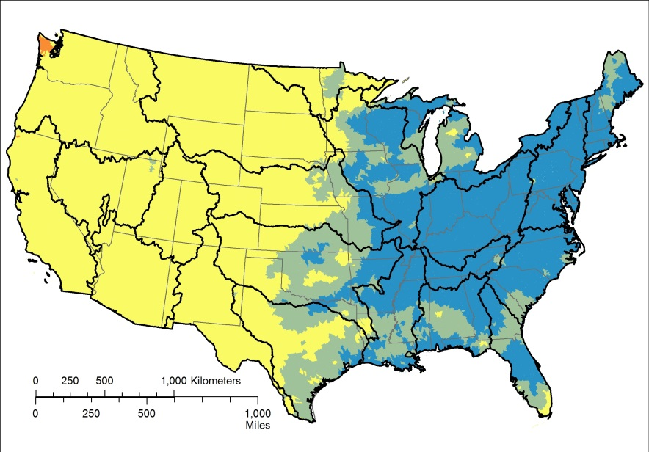
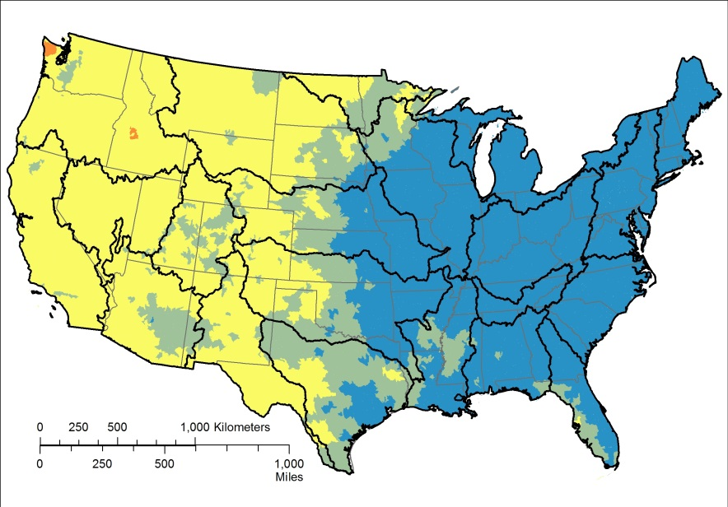
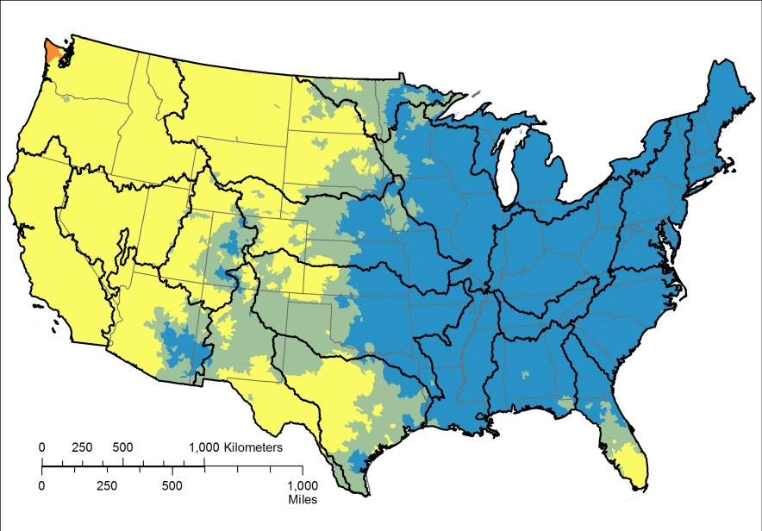
Atmospheric deposition of sulfate, kg/ha, 1985-2012, “atmdep_so4”
10 year change
(2002-2012)
20 year change
(1992-2012)
Period of record change (1985-2012)

Slide 7
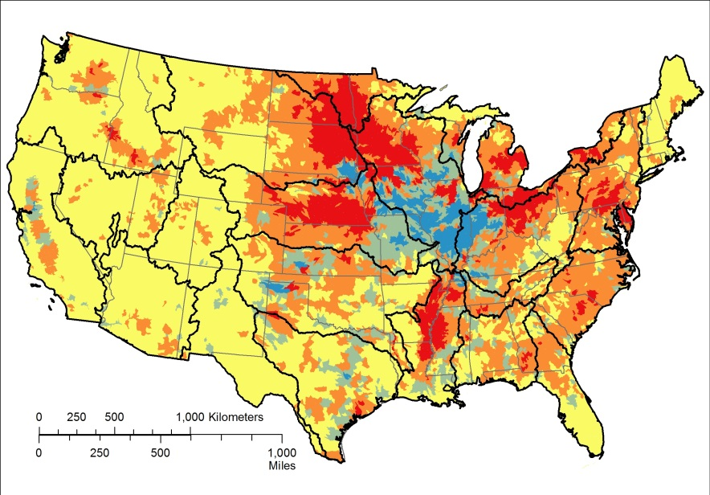
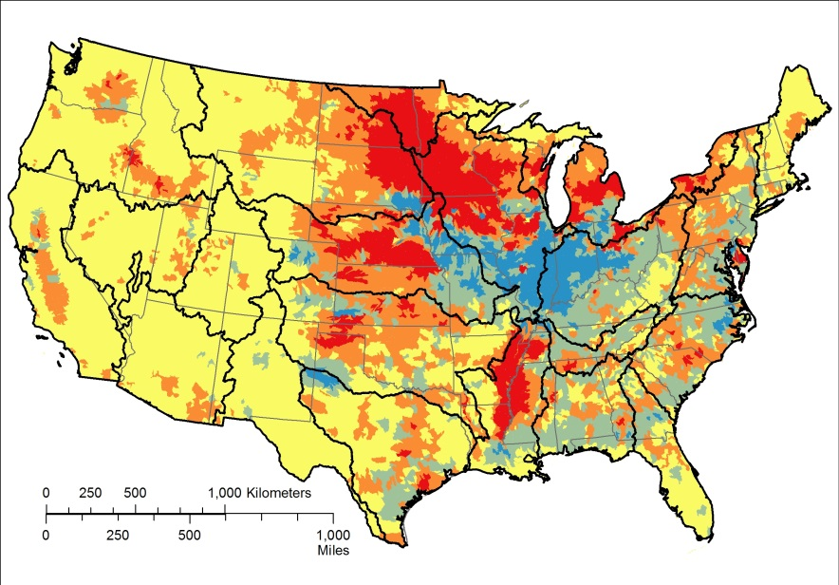
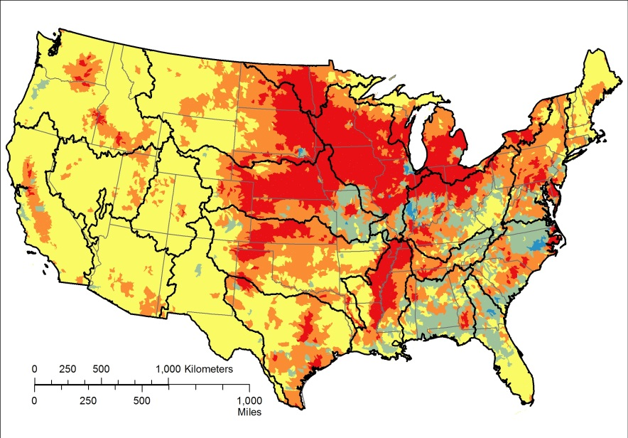
Corn for grain, bushels/sq km, 1969-2012, “corng”
10 year change
(2002-2012)
20 year change
(1992-2012)
Period of record change (1969-2012)

Slide 8
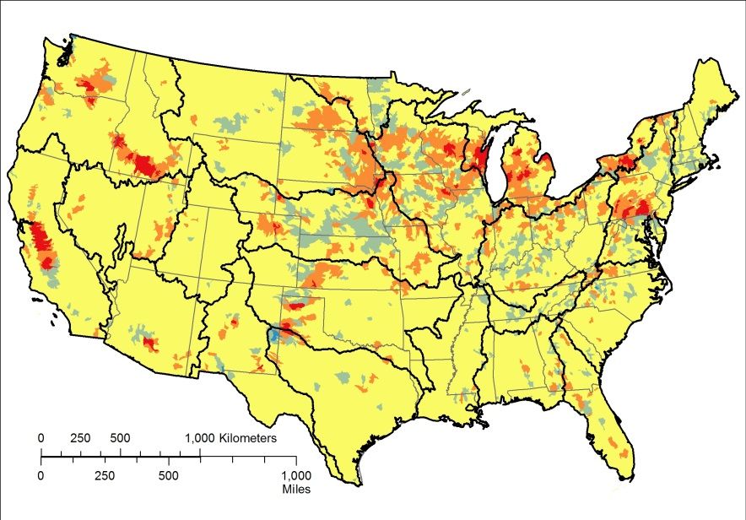
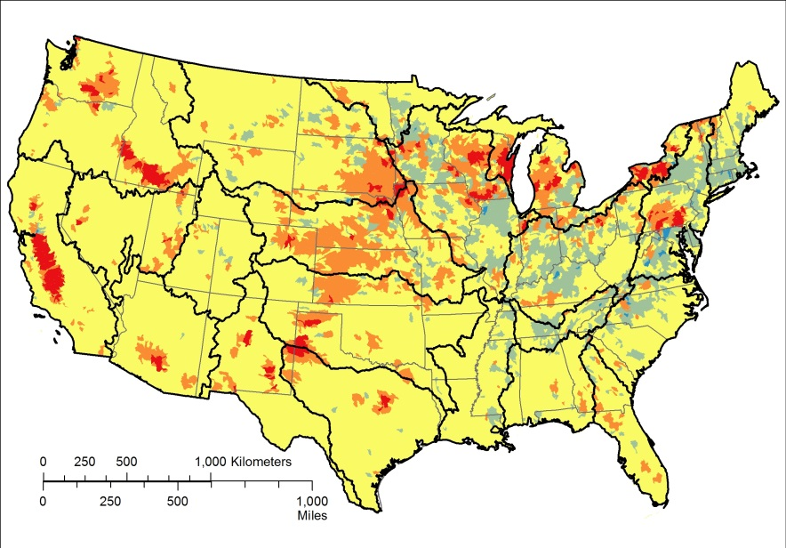
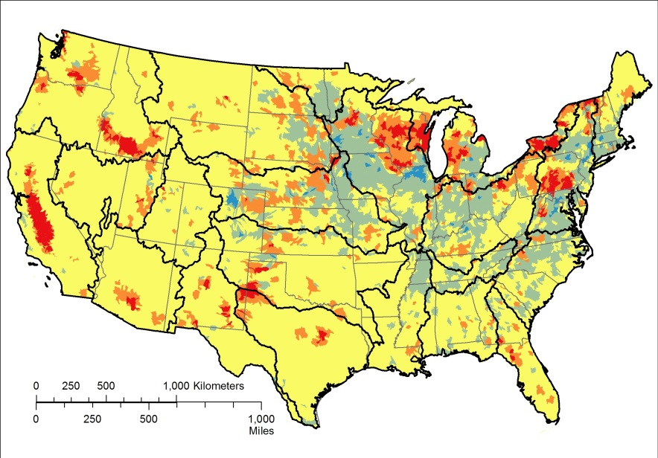
Corn for silage and green chop, green tons/sq km, 1969-2012, “corns”
10 year change
(2002-2012)
20 year change
(1992-2012)
Period of record change (1969-2012)

Slide 9
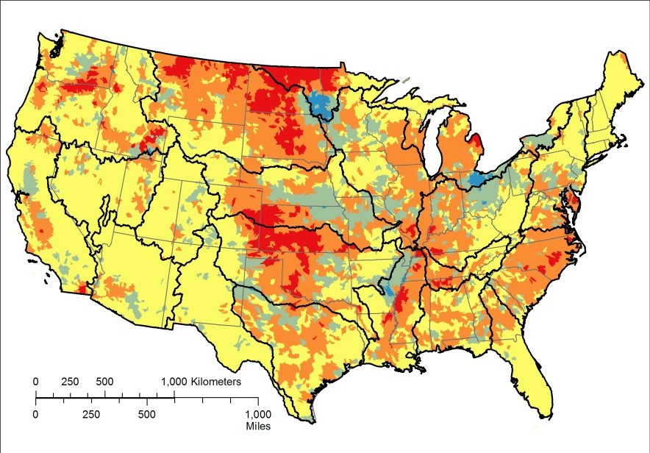
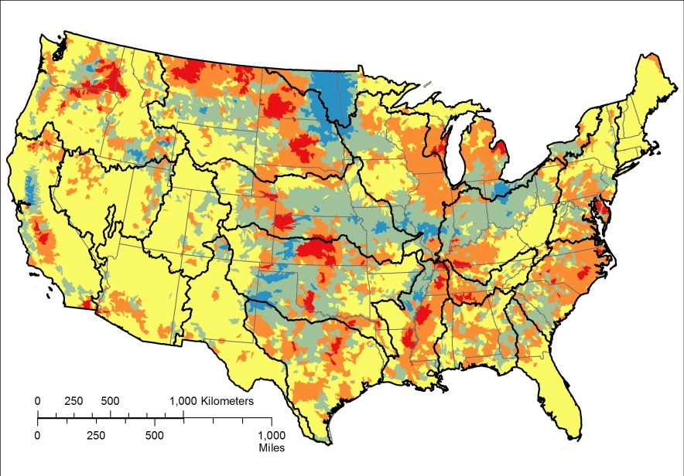
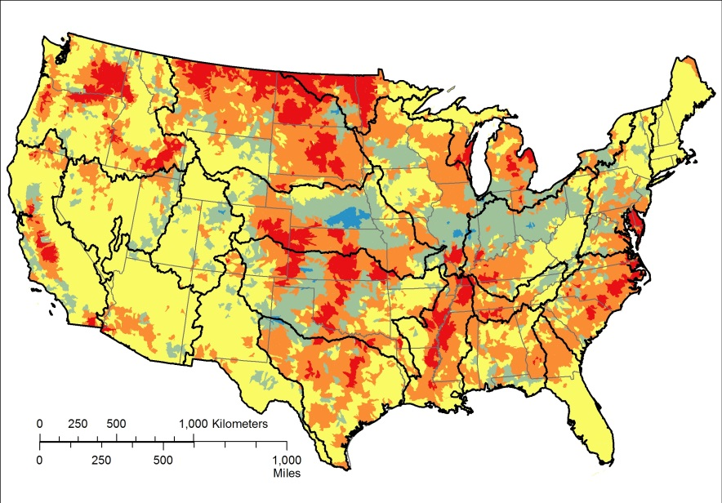
Wheat, bushels/sq km, 1969-2012, “wheat”
10 year change
(2002-2012)
20 year change
(1992-2012)
Period of record change (1969-2012)

Slide 10
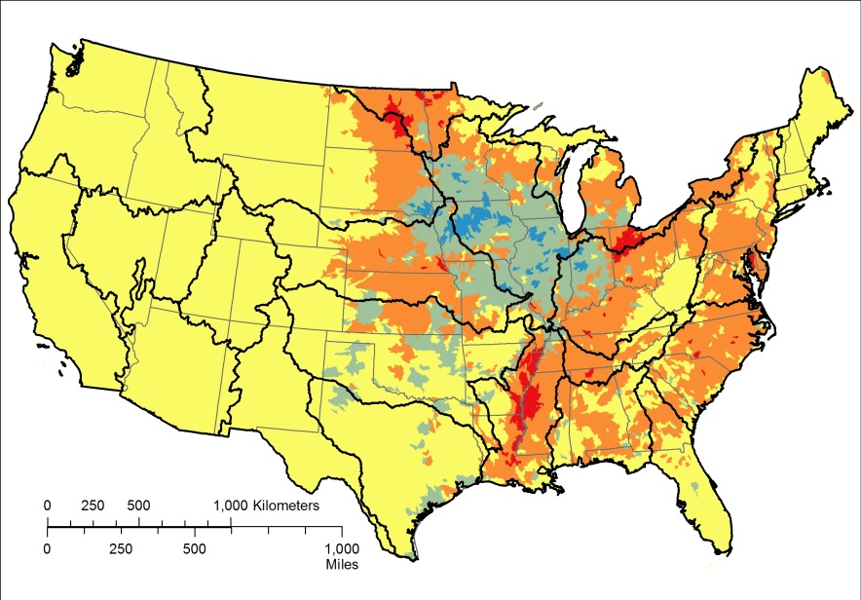
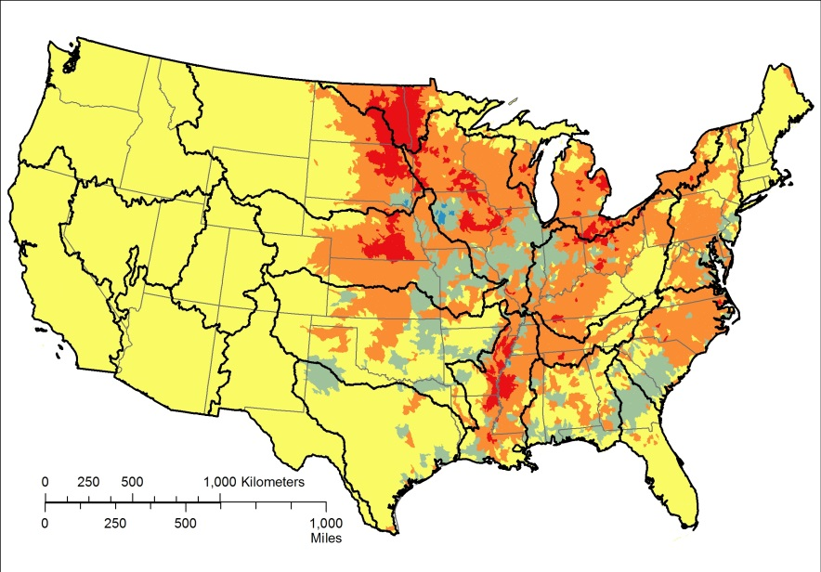
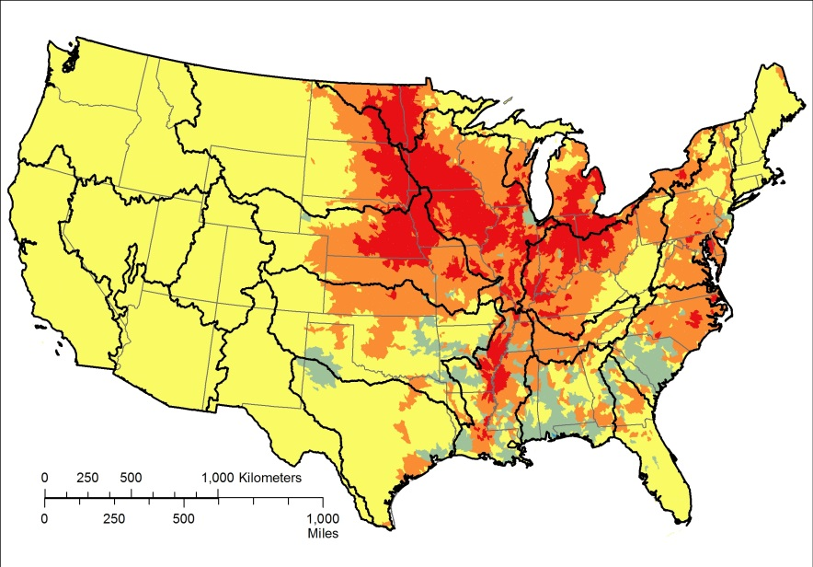
Soybeans, bushels/sq km, 1969-2012, “soybeans”
10 year change
(2002-2012)
20 year change
(1992-2012)
Period of record change (1969-2012)

Slide 11
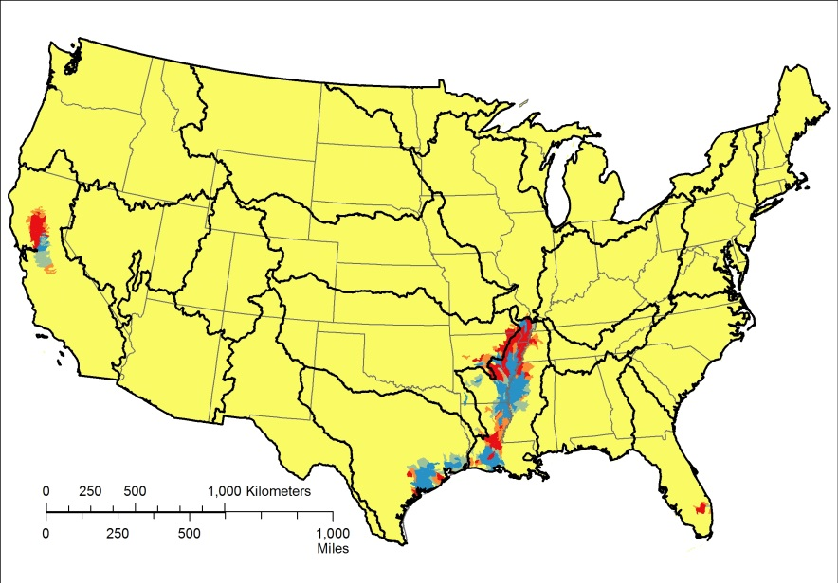

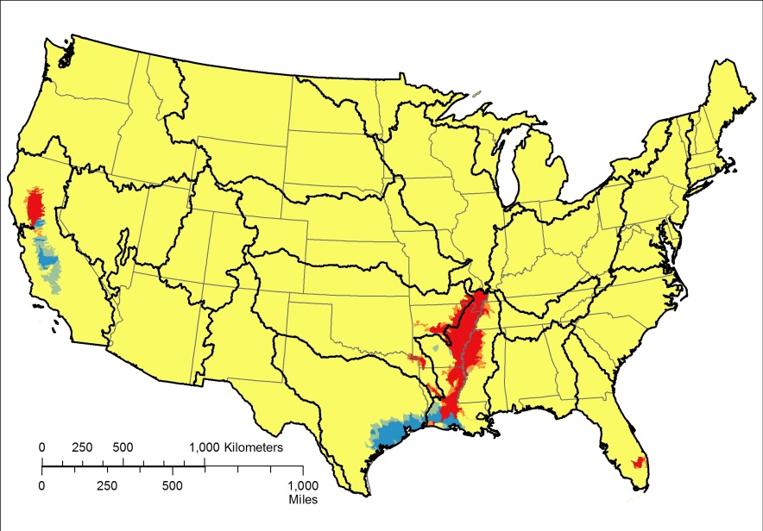
Rice, hundredweight (100 lbs)/sq km, 1969-2012, “rice”
10 year change
(2002-2012)
20 year change
(1992-2012)
Period of record change (1969-2012)

Slide 12
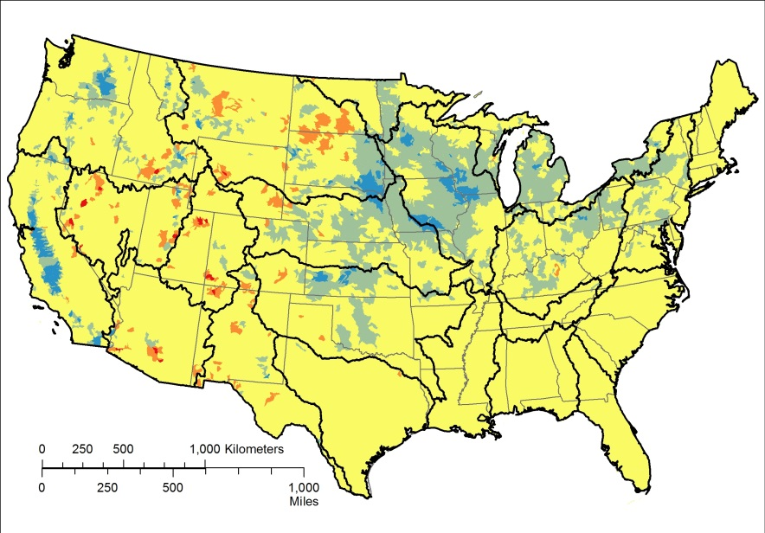
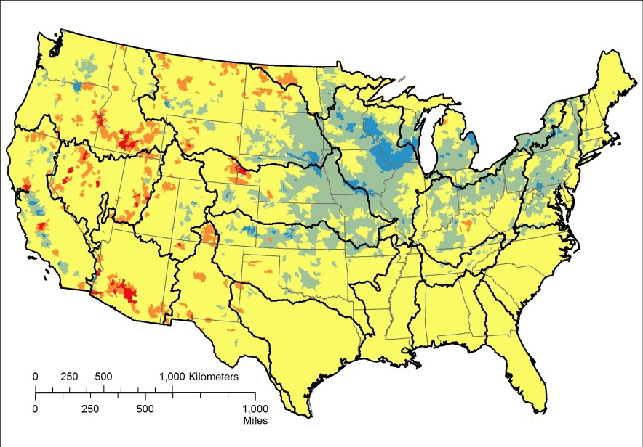
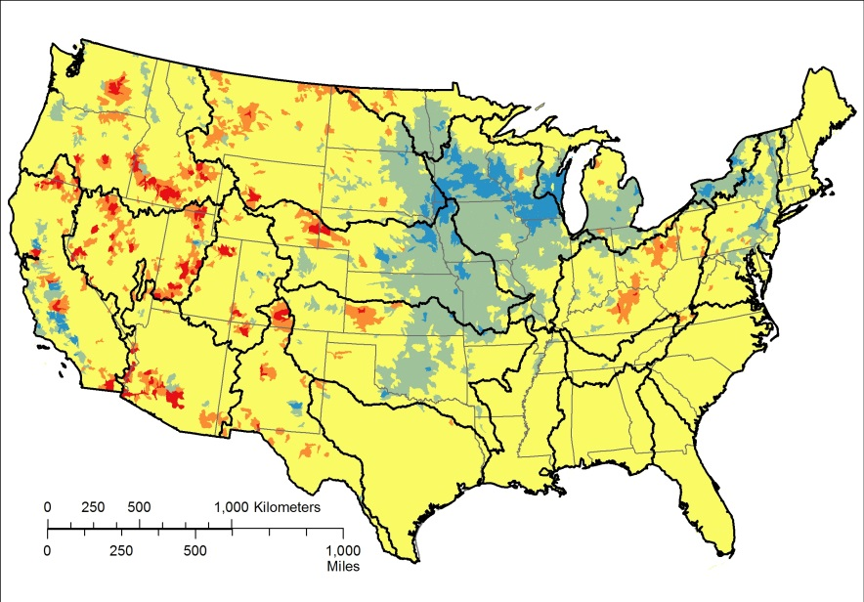
Hay-alfalfa, dry tons/sq km, 1969-2012, “hayalf”
10 year change
(2002-2012)
20 year change
(1992-2012)
Period of record change (1969-2012)

Slide 13
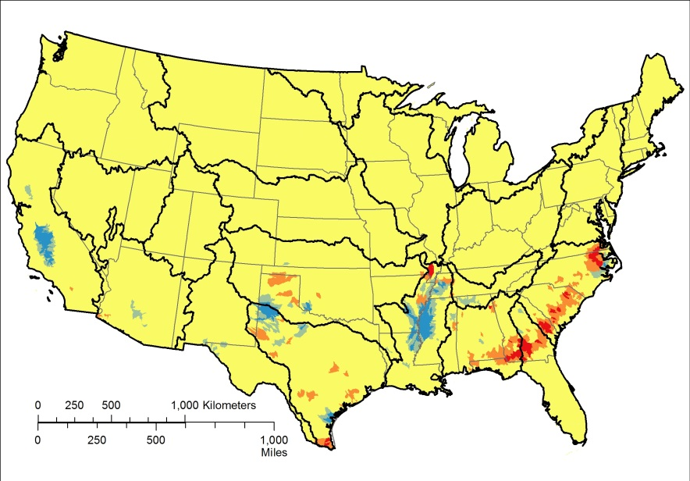
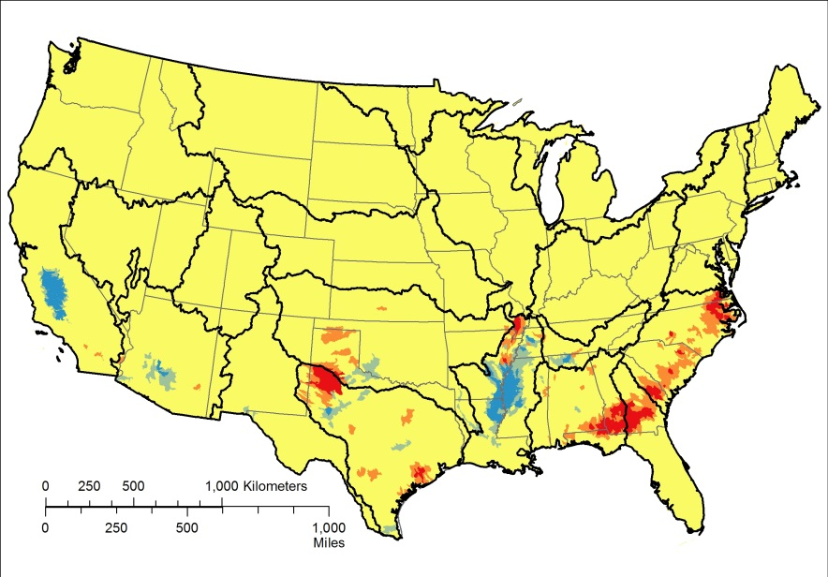
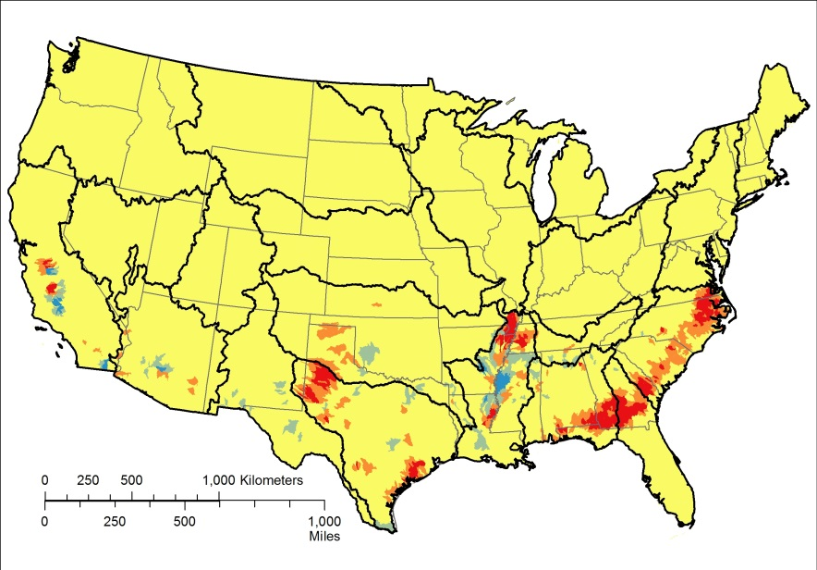
Cotton, bales/sq km, 1969-2012, “cotton”
10 year change
(2002-2012)
20 year change
(1992-2012)
Period of record change (1969-2012)

Slide 14
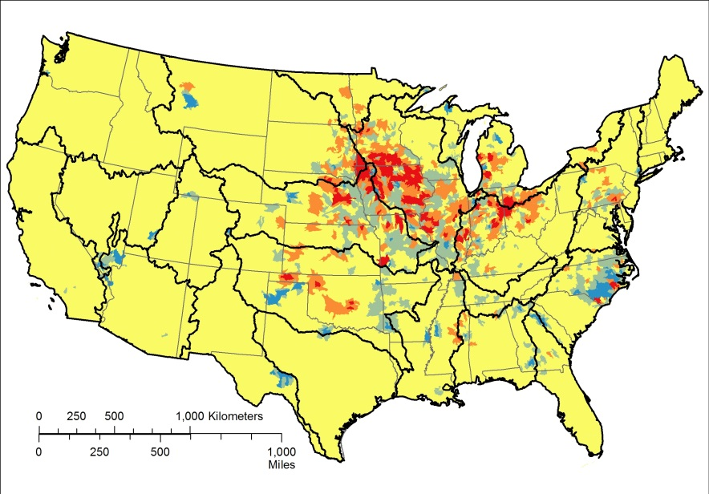
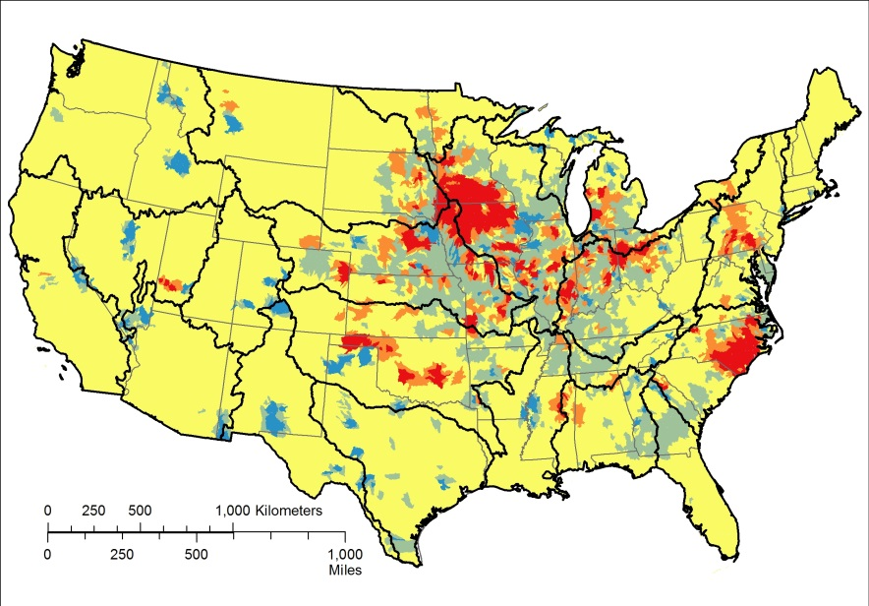
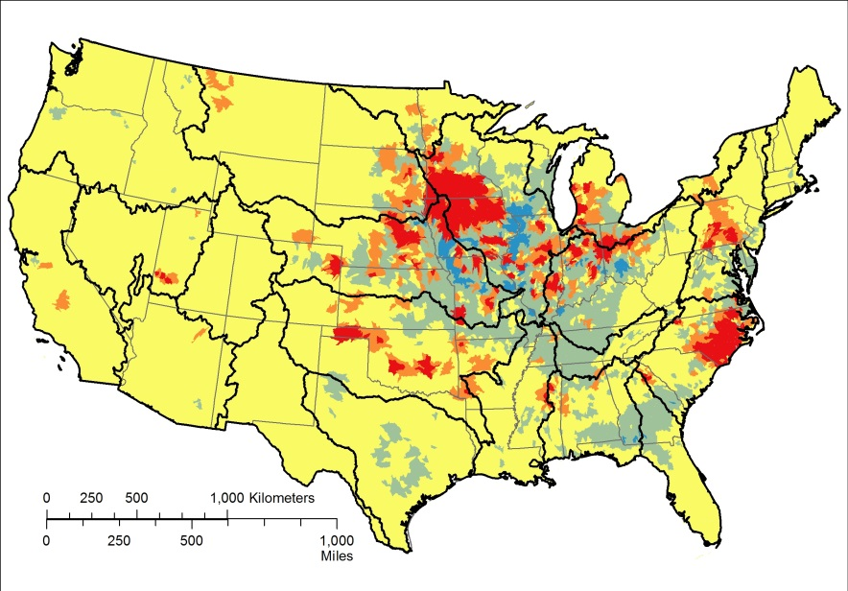
Hogs and pigs/sq km, 1969-2012, “hogs”
10 year change
(2002-2012)
20 year change
(1992-2012)
Period of record change (1969-2012)

Slide 15
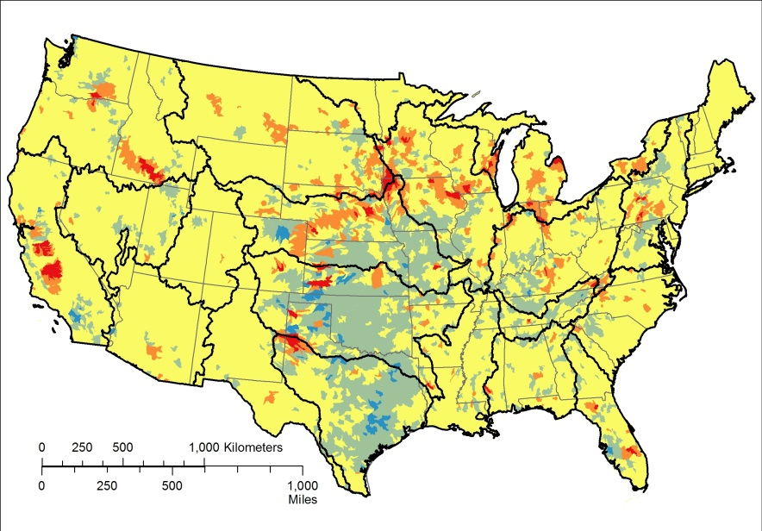
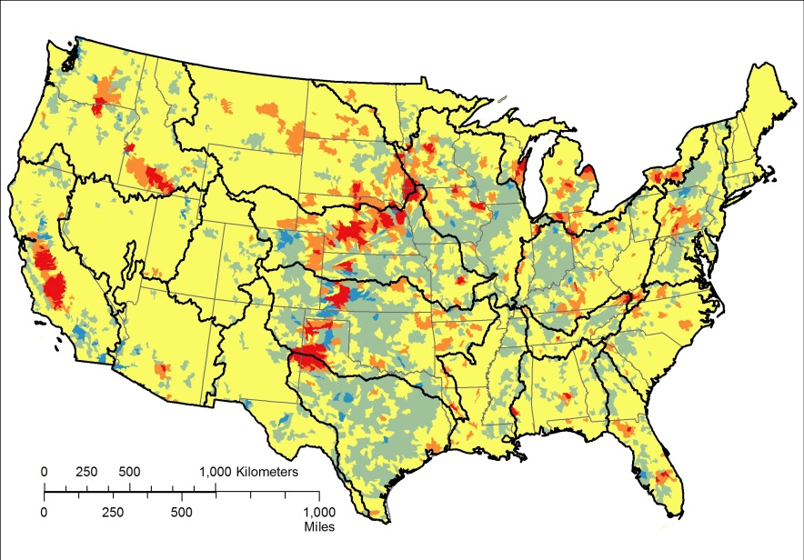
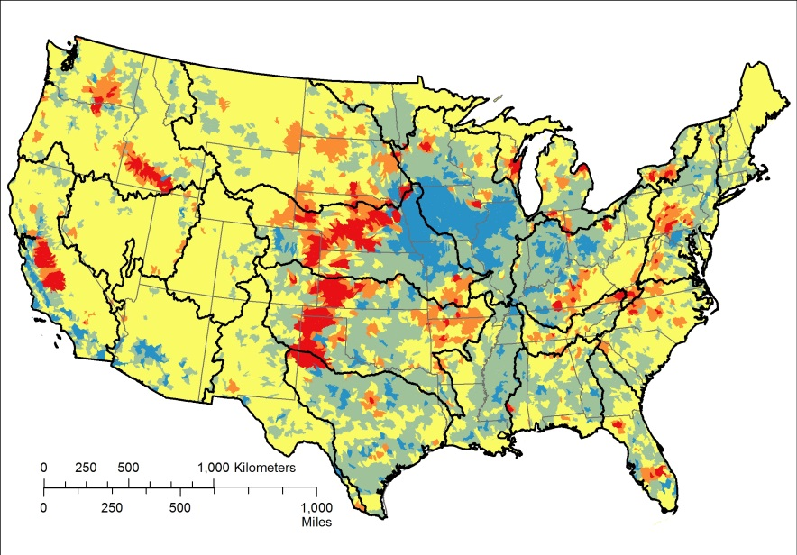
Cows and calves/sq km, 1969-2012, “cows”
10 year change
(2002-2012)
20 year change
(1992-2012)
Period of record change (1969-2012)

Slide 16
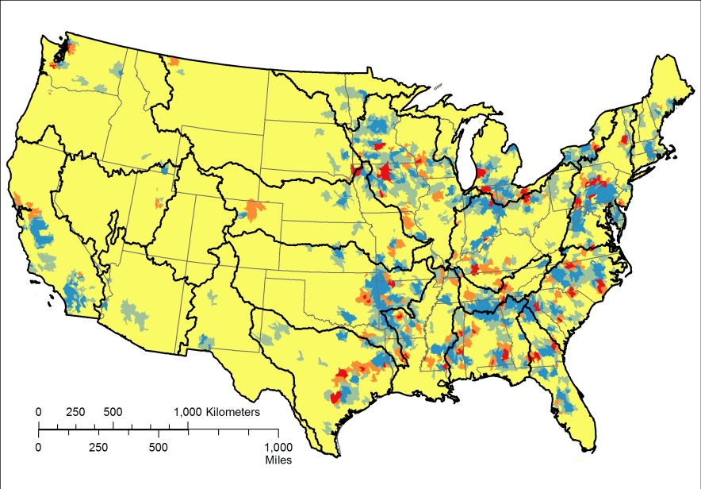
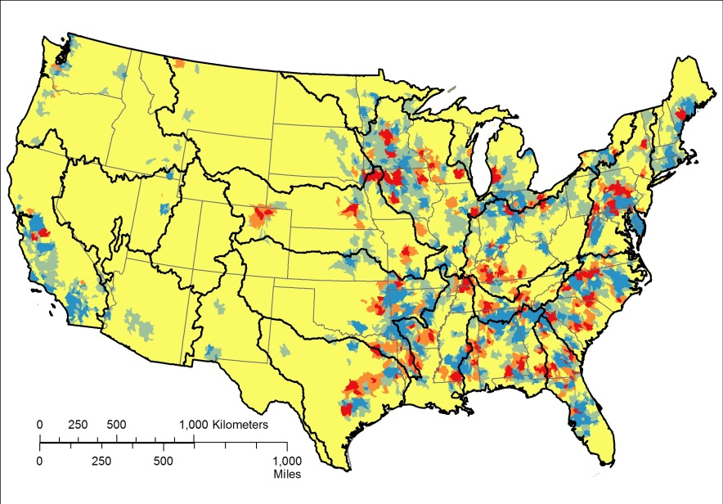
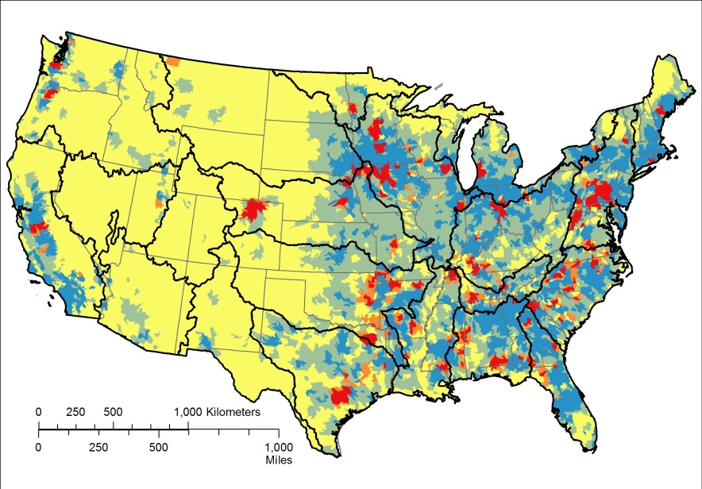
Chickens/sq km, 1969-2012, “chickens” (layer chickens only)
10 year change
(2002-2012)
20 year change
(1992-2012)
Period of record change (1969-2012)

Slide 17
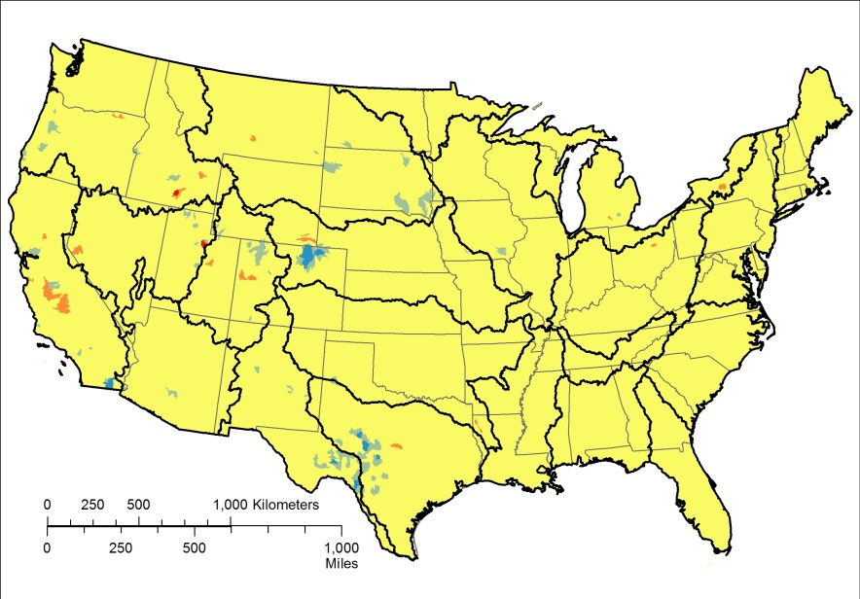
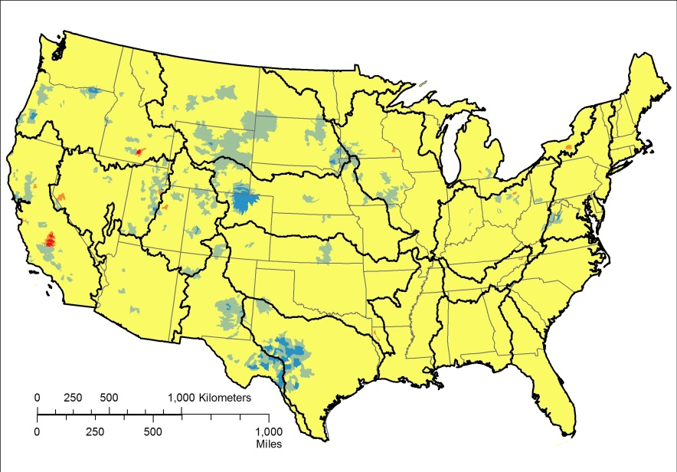
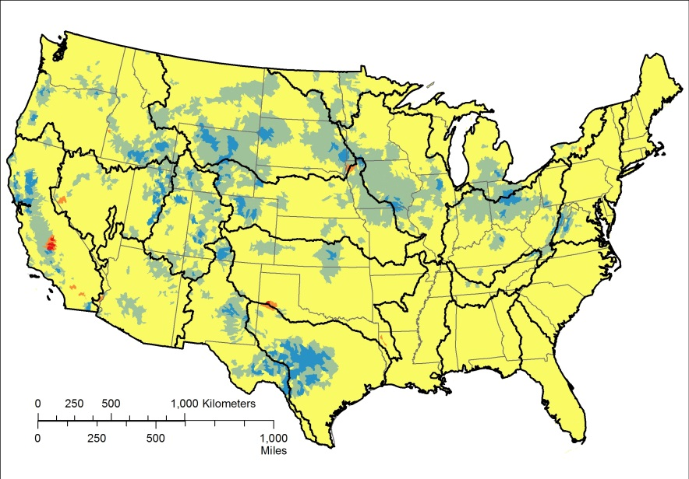
Sheep and lambs/sq km, 1969-2012, “sheep”
10 year change
(2002-2012)
20 year change
(1992-2012)
Period of record change (1969-2012)

Slide 18
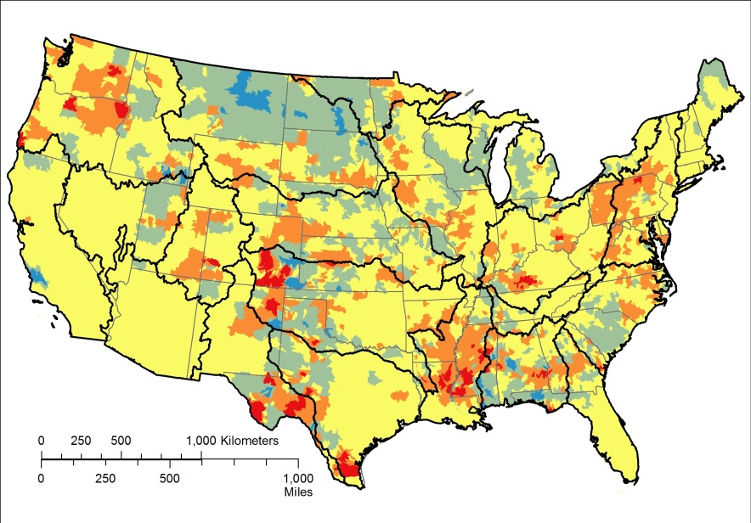
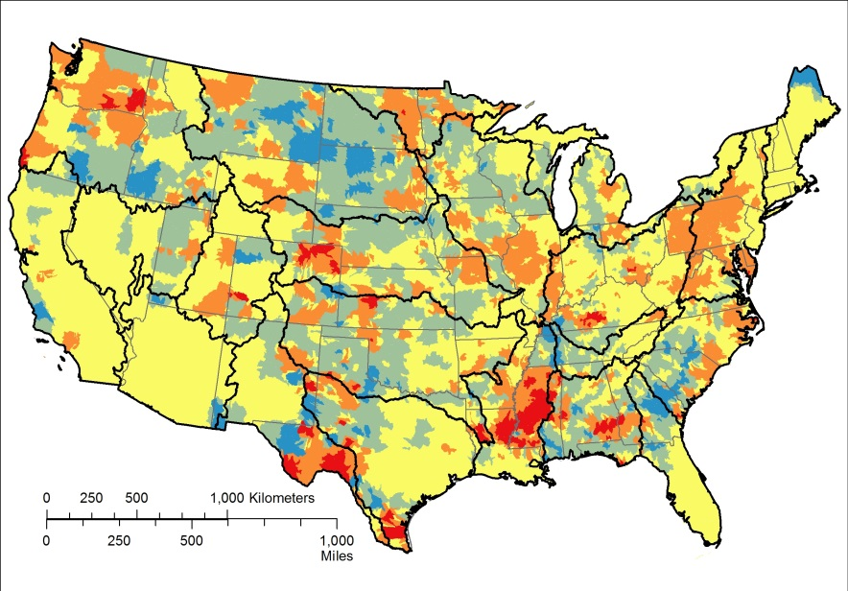
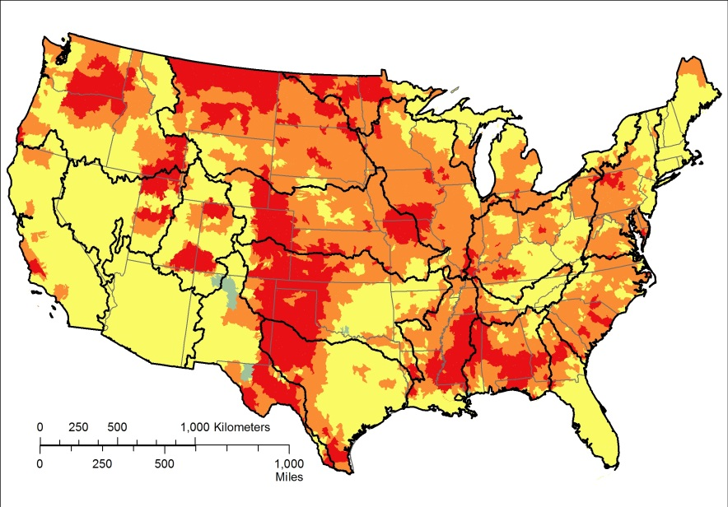
Land in Conservation Reserve Program, percent of total cropland, 1986-2012, “crp”
10 year change
(2002-2012)
20 year change
(1992-2012)
Period of record change (1986-2012)

Slide 19



Dam/reservoir normal storage, acre-feet/sq km, 1972-2013, “dams_normstor”
10 year change
(2002-2013)
20 year change
(1992-2012)
Period of record change (1972-2013)

Slide 20



Dam density, number/100 sq kms, 1972-2013, “dams_density”
10 year change
(2002-2013)
20 year change
(1992-2013)
Period of record change (1972-2013)

Slide 21



Major dam density, number/100 sq kms, 1972-2013, “dams_majdens”
10 year change
(2002-2013)
20 year change
(1992-2012)
Period of record change (1972-2013)

Slide 22



Housing unit density, units/sq km, 1970-2010, “huden”
10 year change
(2000-2010)
20 year change
(1992-2012)
Period of record change (1970-2010)

Slide 23


Population density, persons/sq km, 1990-2010, “popden”
10 year change
(2000-2010)
20 year change
(1990-2010)

Slide 24



Imperviousness, percent of watershed, 1974-2012, from USGS NWALT “imperv_nwalt”
10 year change
(2002-2012)
20 year change
(1992-2012)
Period of record change (1974-2012)

Slide 25

Imperviousness, percent of watershed, 2001-2011, from USGS NLCD “imperv_nlcd”
10 year change
(2001-2011)

Slide 26



Irrigation, percent of watershed, 1969-2012, from Census of Agriculture, “irrig_coa”
10 year change
(2002-2012)
20 year change
(1992-2012)
Period of record change (1969-2012)

Slide 27

Irrigation, percent of watershed, 2002-2012, from USGS data “irrig_usgs”
10 year change
(2002-2012)
20 year change
(1992-2012)

Slide 28



Land use, percent developed land, 1974-2012, from NWALT data “lu_nwalt_dev”
10 year change
(2002-2012)
20 year change
(1992-2012)
Period of record change (1974-2012)

Slide 29



Land use, percent agricultural land, 1974-2012, from NWALT data “lu_nwalt_ag”
10 year change
(2002-2012)
20 year change
(1992-2012)
Period of record change (1974-2012)

Slide 30



Land use, percent developed non-residential land, 1974-2012, from NWALT data “lu_nwalt_dev-nonres”
10 year change
(2002-2012)
20 year change
(1992-2012)
Period of record change (1974-2012)

Slide 31



Land use, percent developed residential land, 1974-2012, from NWALT data “lu_nwalt_dev-res”
10 year change
(2002-2012)
20 year change
(1992-2012)
Period of record change (1974-2012)

Slide 32



Land use, percent cropland, 1974-2012, from NWALT data “lu_nwalt_crops”
10 year change
(2002-2012)
20 year change
(1992-2012)
Period of record change (1974-2012)

Slide 33



Land use, percent mining, 1974-2012, from NWALT data “lu_nwalt_mining”
10 year change
(2002-2012)
20 year change
(1992-2012)
Period of record change (1974-2012)

Slide 34



Land use, percent riparian developed land, 1974-2012, from NWALT data “rip_lu_nwalt_dev”
10 year change
(2002-2012)
20 year change
(1992-2012)
Period of record change (1974-2012)

Slide 35



Land use, percent riparian agricultural land, 1974-2012, from NWALT data “rip_lu_nwalt_ag”
10 year change
(2002-2012)
20 year change
(1992-2012)
Period of record change (1974-2012)

Slide 36

Land use, percent developed land, 2001-2011, from NLCD data “lu_nlcd_dev”
10 year change
(2001-2011)

Slide 37

Land use, percent agricultural land, 2001-2011, from NLCD data “lu_nlcd_ag”
10 year change
(2001-2011)

Slide 38



Nitrogen from farm fertilizer, kg/sq km, 1987-2012, “fert_n”
10 year change
(2002-2012)
20 year change
(1992-2012)
Period of record change (1987-2012)

Slide 39



Phosphorus from farm fertilizer, kg/sq km, 1987-2012, “fert_p”
10 year change
(2002-2012)
20 year change
(1992-2012)
Period of record change (1987-2012)

Slide 40



Nitrogen from manure, kg/sq km, 1982-2012, “manure_n”
10 year change
(2002-2012)
20 year change
(1992-2012)
Period of record change (1982-2012)

Slide 41



Phosphorus from manure, kg/sq km, 1982-2012, “manure_p”
10 year change
(2002-2012)
20 year change
(1992-2012)
Period of record change (1982-2012)

Slide 42


Pesticide 2,4-D, kilograms/sq km, 1992-2012, “pest_24d”
10 year change
(2002-2012)
20 year change
(1992-2012)

Slide 43

Pesticide acetochlor, kilograms/sq km, 1997-2012, “pest_aceto”
10 year change
(2002-2012)

Slide 44


Pesticide alachlor, kilograms/sq km, 1992-2012, “pest_alach”
10 year change
(2002-2012)
20 year change
(1992-2012)

Slide 45


Pesticide atrazine, kilograms/sq km, 1992-2012, “pest_atraz”
10 year change
(2002-2012)
20 year change
(1992-2012)

Slide 46


Pesticide carbaryl, kilograms/sq km, 1992-2012, “pest_carba”
10 year change
(2002-2012)
20 year change
(1992-2012)

Slide 47


Pesticide chlorpyrifos, kilograms/sq km, 1992-2012, “pest_chlor”
10 year change
(2002-2012)
20 year change
(1992-2012)

Slide 48


Pesticide diazinon, kilograms/sq km, 1992-2012, “pest_diazi”
10 year change
(2002-2012)
20 year change
(1992-2012)

Slide 49


Pesticide dicamba, kilograms/sq km, 1992-2012, “pest_dicam”
10 year change
(2002-2012)
20 year change
(1992-2012)

Slide 50

Pesticide fipronil, kilograms/sq km, 2002-2012, “pest_fipro”
10 year change
(2002-2012)

Slide 51


Pesticide glyphosate, kilograms/sq km, 1992-2012, “pest_glyph”
10 year change
(2002-2012)
20 year change
(1992-2012)

Slide 52

Pesticide ididacloprid, kilograms/sq km, 1997-2012, “pest_imida”
10 year change
(2002-2012)

Slide 53


Pesticide malathion, kilograms/sq km, 1992-2012, “pest_malat”
10 year change
(2002-2012)
20 year change
(1992-2012)

Slide 54


Pesticide metolachlor, kilograms/sq km, 1992-2012, “pest_meto”
10 year change
(2002-2012)
20 year change
(1992-2012)

Slide 55


Pesticide simazine, kilograms/sq km, 1992-2012, “pest_simaz”
10 year change
(2002-2012)
20 year change
(1992-2012)

Slide 56


Pesticide tebuthiuron, kilograms/sq km, 1992-2012, “pest_tebut”
10 year change
(2002-2012)
20 year change
(1992-2012)

Slide 57

Pesticide thiamethoxam, kilograms/sq km, 2002-2012, “pest_thiam”
10 year change
(2002-2012)

Slide 58


Road salt, pounds/sq km, 1992-2012, “roadsalt”
10 year change
(2002-2012)
20 year change
(1992-2012)

Slide 59

Timber and forest cutting, percent, 2002-2012, “timber”
10 year change
(2002-2012)

Slide 60



Water use, freshwater withdrawals, mgd/sq km, 1985-2010, “wateruse”
10 year change
(2000-2010)
20 year change
(1990-2010)
Period of record change (1985-2010)

Slide 61



Nitrogen from WWTPs, kg/sq km, 1978-2012, “wwtp_n”
8 year change
(2004-2012)
20 year change
(1992-2012)
Period of record change (1978-2012)

Slide 62



Phosphorus from WWTPs, kg/sq km, 1978-2012, “wwtp_p”
8 year change
(2004-2012)
20 year change
(1992-2012)
Period of record change (1978-2012)

